Slide 1

ALPHA ARENA / STRATEGY REVIEW
Three market-trend
strategies
A simple comparison of returns, risk and cost
Backtest metrics supplied for this presentation
Photo: Tigran Hambardzumyan / Unsplash
Notes:
Cover photo: Tigran Hambardzumyan, Unsplash. https://unsplash.com/photos/a-desk-with-a-laptop-and-a-monitor-on-it-KiW_vHxjhQE

Slide 2
Performance snapshot
SUPPLIED SUMMARY METRICS
Metric | Strategy 1 | Strategy 2 | Strategy 3
Return | 21.90% | 19.83% | 19.29%
Sharpe ratio | 1.476 | 1.487 | 1.498
Calmar ratio | 1.996 | 2.006 | 2.002
Maximum drawdown | -5.22% | -4.72% | -4.60%
Trading accuracy | 51.37% | 51.37% | 51.37%
Costs paid | 0.42% | 0.32% | 1.12%
Average exposure | 48.02% | 43.51% | 43.51%
Highest table return • Strategy 1 • 21.90%
Highest table Sharpe • Strategy 3 • 1.498
Lowest table costs • Strategy 2 • 0.32%
2 / 5
Notes:
Source: all metric values in this table were supplied by the user. The return comparison graph supplied separately by the user appears on the next slide.

Slide 3
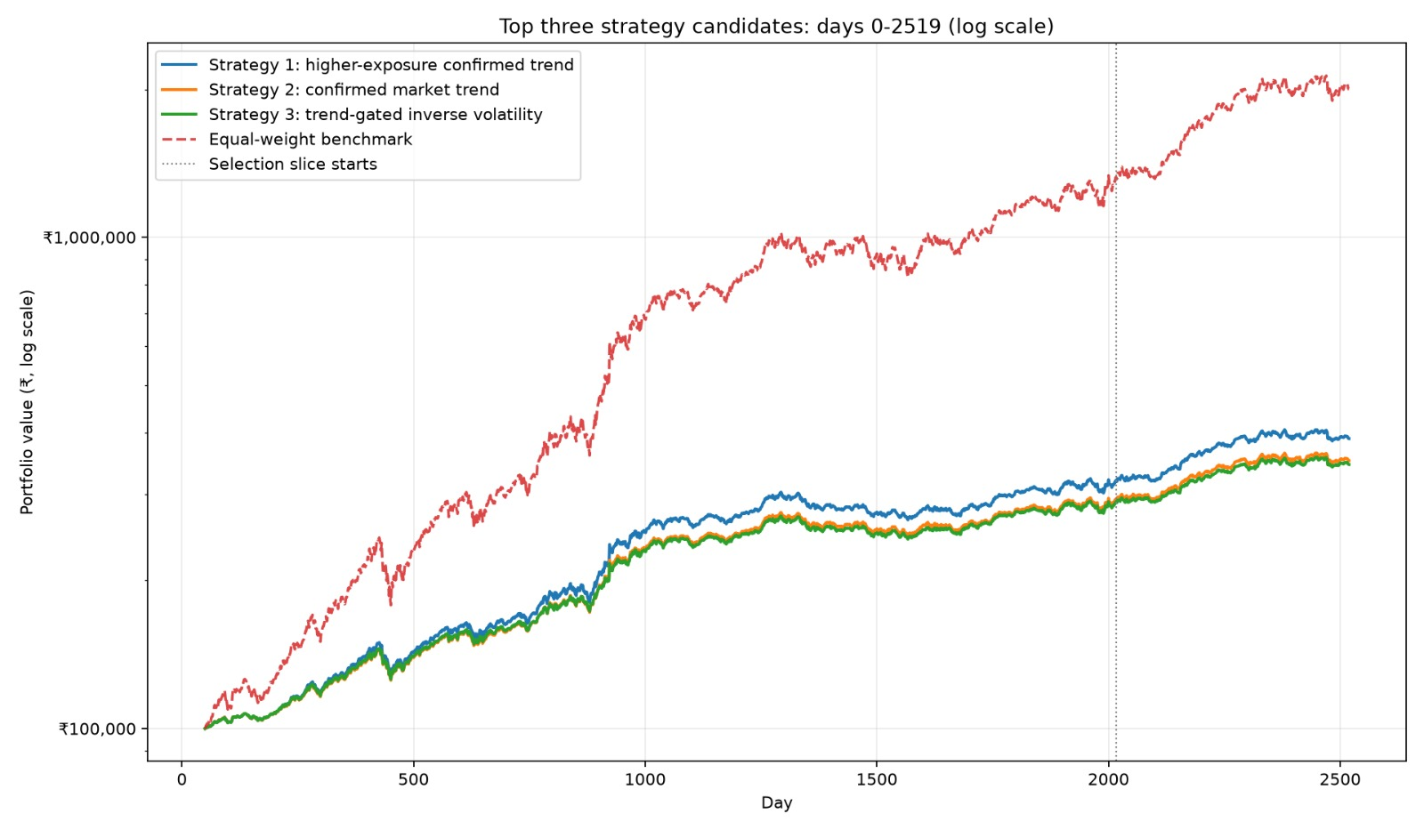
Notes:
Graph image supplied by the user. The graph title, data series, log scale, selection marker and legend are preserved from the attachment.

Slide 4

How the three strategies work
STRATEGY 1 / HIGHER EXPOSURE
STRATEGY 2 / LOWER RISK
STRATEGY 3 / INVERSE VOLATILITY
Invest equally across stocks.
50% exposure when the broad index is above its 200-day average and has positive 126-day momentum; otherwise 30%.
Why use it: Highest stated rationale return (289.18%). Drawdown -14.98%, just inside the 15% limit; Calmar 0.993, just below 1.
Use the same market confirmation and equal stock weights.
Exposure is 45% when the trend is positive and 30% otherwise.
Why use it: Lowest stated drawdown (-13.48%) and only Calmar above 1 (1.014), with a stated 250.97% return.
Use Strategy 2's 45% / 30% market exposure.
Give more weight to stocks with lower recent 63-day volatility.
Why use it: Highest stated Sharpe (1.548), but also the highest stated costs (6.39%).
Photo: Unsplash
The return, drawdown and cost values above come from the strategy rationale text; they differ from the summary table.
4 / 5
Notes:
Photo source: Unsplash image https://images.unsplash.com/photo-1620266757065-5814239881fd
The rationale figures are presented as provided. They do not match the separate summary metrics table; confirm periods and definitions before external use.

Slide 5
Choose by priority
No single strategy leads on every measure in the figures you provided.
RETURN
DRAWDOWN / CALMAR
SHARPE
Strategy 1
Strategy 2
Strategy 3
Highest stated return: 289.18%. Its Calmar (0.993) narrowly misses the 1.0 target.
Lowest stated drawdown: -13.48%. Only strategy with Calmar above 1 (1.014).
Highest stated Sharpe: 1.548. It also has the highest stated costs: 6.39%.
DATA NOTE
Return, drawdown, Sharpe and cost figures in the summary table differ from some rationale figures. The figures may use different periods or definitions; verify before treating them as one result set.
Source: user-provided metrics and strategy descriptions. Photos: Tigran Hambardzumyan and Raj Rana / Unsplash.
5 / 5
Notes:
All strategy metrics are user-provided. The provided summary metrics conflict with some of the rationale figures; this slide intentionally keeps them distinct. The photos are illustrative and are not backtest data.

